Slide 1
Treasury Services
Done by,
Sushmitha U (XBBNLB5)
Sai Akhil G (XBBNLDU)
Mithun J (XBBNLD4)

Slide 2






Slide 3
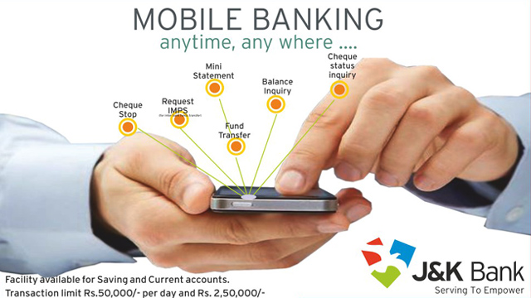







Slide 4




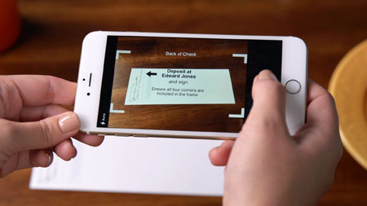

Slide 5





